Slide 1

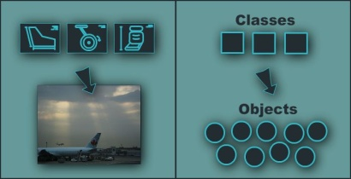
Fundamental Principles of OOP
Notes:
(c) 2006 National Academy for Software Development - http://academy.devbg.org*
1##

Slide 2
Fundamental Principles of OOP
Inheritance
Inherit members from parent class
Abstraction
Define and execute abstract actions
Encapsulation
Hide the internals of a class
Polymorphism
Access a class through its parent interface
2

Slide 3
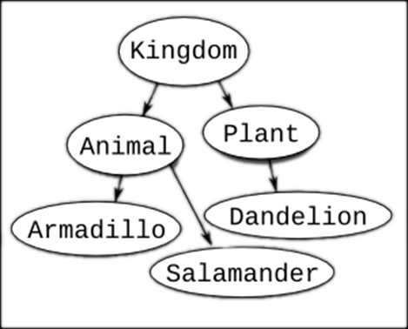
Inheritance
Notes:
(c) 2006 National Academy for Software Development - http://academy.devbg.org*
3##

Slide 4
Classes and Interfaces
Classes define attributes and behavior
Fields, properties, methods, etc.
Methods contain code for execution
Interfaces define a set of operations
Empty methods and properties, left to be implemented later
public class Labyrinth { … }
public interface IFigure { … }

Slide 5
Inheritance
Inheritance allows child classes inherits the characteristics of existing parent class
Attributes (fields and properties)
Operations (methods)
Child class can extend the parent class
Add new fields and methods
Redefine methods (modify existing behavior)
A class can implement an interface by providing implementation for all its methods
5

Slide 6
Types of Inheritance
Inheritance terminology
base class /
parent class
derived class
inherits
class
implements
interface
derived interface
implements
base interface
6

Slide 7

Inheritance – Benefits
Inheritance has a lot of benefits
Extensibility
Reusability
Provides abstraction
Eliminates redundant code
Use inheritance for buidling is-a relationships
E.g. dog is-a animal (dogs are kind of animals)
Don't use it to build has-a relationship
E.g. dog has-a name (dog is not kind of name)
7
Notes:
Extensibility / Polymorphism: New functionality may be easily plugged in without changing existing classes as long the new plug-in classes extend given base classes.
Reusability: For a set of similar applications a framework can be defined using a core set of classes that are to be extended by classes that fill in the application-dependent part.
Information Hiding: If a more general class using a simpler contract is sufficient, details from extending classes may be hidden to some of the client classes. This allows them to be more independent from possible changes and diminishes the load of contracts that must be understood by a reader of these client classes.
(c) 2006 National Academy for Software Development - http://academy.devbg.org*
7##

Slide 8
Inheritance – Example
Base class
Person
+Name: String
+Address: String
Derived class
Derived class
Employee
Student
+Company: String
+Salary: double
+School: String
8

Slide 9
Class Hierarchies
Inheritance leads to a hierarchy of classes and/or interfaces in an application:
Game
SinglePlayerGame
MultiplePlayersGame
Minesweeper
Solitaire
BoardGame
…
…
Chess
Backgammon
9

Slide 10
Inheritance in .NET
A class can inherit only one base class
E.g. IOException derives from SystemException and it derives from Exception
A class can implement several interfaces
This is .NET’s form of multiple inheritance
E.g. List<T> implements IList<T>, ICollection<T>, IEnumerable<T>
An interface can implement several interfaces
E.g. IList<T> implements ICollection<T> and IEnumerable<T>
10

Slide 11


How to Define Inheritance?
We must specify the name of the base class after the name of the derived
In the constructor of the derived class we use the keyword base to invoke the constructor of the base class
public class Shape
{...}
public class Circle : Shape
{...}
public Circle (int x, int y) : base(x)
{...}

Slide 12

Simple Inheritance Example
public class Mammal
{
public int Age { get; set; }
public Mammal(int age)
{
this.Age = age;
}
public void Sleep()
{
Console.WriteLine("Shhh! I'm sleeping!");
}
}

Slide 13

Simple Inheritance Example (2)
public class Dog : Mammal
{
public string Breed { get; set; }
public Dog(int age, string breed)
: base(age)
{
this.Breed = breed;
}
public void WagTail()
{
Console.WriteLine("Tail wagging...");
}
}

Slide 14

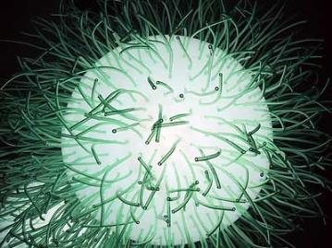
Simple Inheritance
Live Demo

Slide 15
Accessibility Levels
Access modifiers in C#
public – access is not restricted
private – access is restricted to the containing type
protected – access is limited to the containing type and types derived from it
internal – access is limited to the current assembly
protected internal – access is limited to the current assembly or types derived from the containing class

Slide 16
Inheritance and Accessibility
class Creature
{
protected string Name { get; private set; }
private void Talk()
{
Console.WriteLine("I am creature ...");
}
protected void Walk()
{
Console.WriteLine("Walking ...");
}
}
class Mammal : Creature
{
// base.Talk() can be invoked here
// this.Name can be read but cannot be modified here
}

Slide 17
Inheritance and Accessibility (2)
class Dog : Mammal
{
public string Breed { get; private set; }
// base.Talk() cannot be invoked here (it is private)
}
class InheritanceAndAccessibility
{
static void Main()
{
Dog joe = new Dog(6, "Labrador");
Console.WriteLine(joe.Breed);
// joe.Walk() is protected and can not be invoked
// joe.Talk() is private and can not be invoked
// joe.Name = "Rex"; // Name cannot be accessed here
// joe.Breed = "Shih Tzu"; // Can't modify Breed
}
}

Slide 18

Inheritance and Accessibility
Live Demo

Slide 19
Inheritance: Important Aspects
Structures cannot be inherited
In C# there is no multiple inheritance
Only multiple interfaces can be implemented
Instance and static constructors are not inherited
Inheritance is transitive relation
If C is derived from B, and B is derived from A, then C inherits A as well

Slide 20
Inheritance: Important Features
A derived class extends its base class
It can add new members but cannot remove derived ones
Declaring new members with the same name or signature hides the inherited ones
A class can declare virtual methods and properties
Derived classes can override the implementation of these members
E.g. Object.Equals() is virtual method

Slide 21



Abstraction
Notes:
(c) 2006 National Academy for Software Development - http://academy.devbg.org*
21##

Slide 22

Abstraction
Abstraction means ignoring irrelevant features, properties, or functions and emphasizing the relevant ones ...
... relevant to the given project (with an eye to future reuse in similar projects)
Abstraction = managing complexity
"Relevant" to what?
22

Slide 23
Abstraction (2)
Abstraction is something we do every day
Looking at an object, we see those things about it that have meaning to us
We abstract the properties of the object, and keep only what we need
E.g. students get "name" but not "color of eyes"
Allows us to represent a complex reality in terms of a simplified model
Abstraction highlights the properties of an entity that we need and hides the others
23

Slide 24

Abstraction in .NET
In .NET abstraction is achieved in several ways:
Abstract classes
Interfaces
Inheritance
Control
+click()
ButtonBase
+Color : long
Button
RadioButton
CheckBox
24

Slide 25
Abstraction in .NET – Example
System.Object
System.MarshalByRefObject
System.ComponentModel.Component
System.Windows.Forms.Control
System.Windows.Forms.ButtonBase
System.Windows.Forms.Button
25

Slide 26
Interfaces in C#
An interface is a set of operations (methods) that given object can perform
Also called "contract" for supplying a set of operations
Defines abstract behavior
Interfaces provide abstractions
You shouldn't have to know anything about what is in the implementation in order to use it
26

Slide 27
Abstract Classes in C#
Abstract classes are special classes defined with the keyword abstract
Mix between class and interface
Partially implemented or fully unimplemented
Not implemented methods are declared abstract and are left empty
Cannot be instantiated
Child classes should implement abstract methods or declare them as abstract
27

Slide 28

Abstract Data Types
Abstract Data Types (ADT) are data types defined by a set of operations (interface)
Example:
«interface»
IList<T>
+Add(item : Object)
+Remove(item : Object)
+Clear()
…
LinkedList<T>
List<T>
28

Slide 29
Inheritance Hierarchies
Using inheritance we can create inheritance hierarchies
Easily represented by UML class diagrams
UML class diagrams
Classes are represented by rectangles containing their methods and data
Relations between classes are shown as arrows
Closed triangle arrow means inheritance
Other arrows mean some kind of associations

Slide 30
UML Class Diagram – Example
interface
Shape
struct
ISurfaceCalculatable
Point
#Position:Point
+CalculateSurface:float
+X:int
+Y:int
+Point
Square
Rectangle
struct
Color
-Size:float
-Width:float
-Height:float
+RedValue:byte
+Square
+GreenValue:byte
+CalculateSurface:float
+Rectangle
+BlueValue:byte
+CalculateSurface:float
+Color
FilledSquare
FilledRectangle
-Color:Color
-Color:Color
+FilledSquare
+FilledRectangle

Slide 31
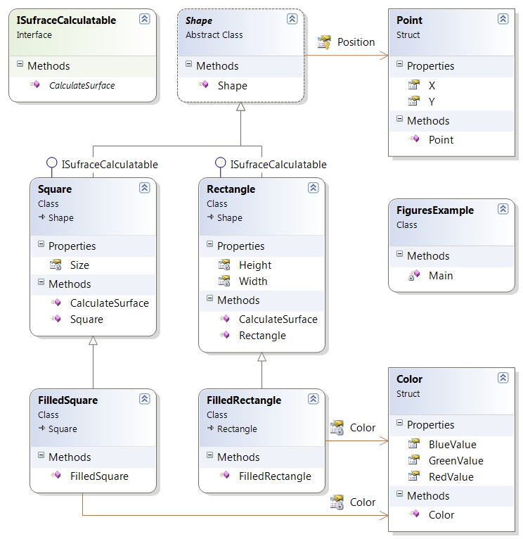
Class Diagrams in Visual Studio
Live Demo

Slide 32



Encapsulation
Notes:
(c) 2006 National Academy for Software Development - http://academy.devbg.org*
32##

Slide 33
Encapsulation
Encapsulation hides the implementation details
Class announces some operations (methods) available for its clients – its public interface
All data members (fields) of a class should be hidden
Accessed via properties (read-only and read-write)
No interface members should be hidden
33

Slide 34
Encapsulation – Example
Data fields are private
Constructors and accessors are defined (getters and setters)
Person
-name : string
-age : TimeSpan
+Person(string name, int age)
+Name : string { get; set; }
+Age : TimeSpan { get; set; }
34

Slide 35
Encapsulation in .NET
Fields are always declared private
Accessed through properties in read-only or read-write mode
Constructors are almost always declared public
Interface methods are always public
Not explicitly declared with public
Non-interface methods are declared private / protected
35

Slide 36
Encapsulation – Benefits
Ensures that structural changes remain local:
Changing the class internals does not affect any code outside of the class
Changing methods' implementation does not reflect the clients using them
Encapsulation allows adding some logic when accessing client's data
E.g. validation on modifying a property value
Hiding implementation details reduces complexity → easier maintenance
36

Slide 37
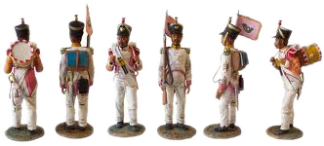
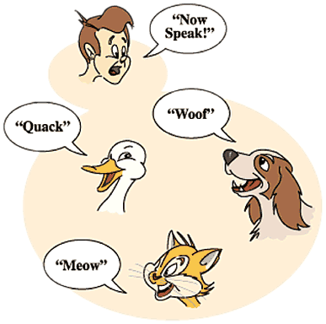
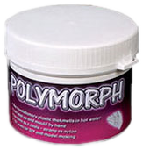
Polymorphism
Notes:
(c) 2006 National Academy for Software Development - http://academy.devbg.org*
37##

Slide 38
Polymorphism
Polymorphism = ability to take more than one form (objects have more than one type)
A class can be used through its parent interface
A child class may override some of the behaviors of the parent class
Polymorphism allows abstract operations to be defined and used
Abstract operations are defined in the base class' interface and implemented in the child classes
Declared as abstract or virtual
38

Slide 39
Polymorphism (2)
Why handle an object of given type as object of its base type?
To invoke abstract operations
To mix different related types in the same collection
E.g. List<object> can hold anything
To pass more specific object to a method that expects a parameter of a more generic type
To declare a more generic field which will be initialized and "specialized" later
39

Slide 40
Virtual Methods
Virtual method is method that can be used in the same way on instances of base and derived classes but its implementation is different
A method is said to be a virtual when it is declared as virtual
Methods that are declared as virtual in a base class can be overridden using the keyword override in the derived class
public virtual void CalculateSurface()

Slide 41
The override Modifier
Using override we can modify a method or property
An override method provides a new implementation of a member inherited from a base class
You cannot override a non-virtual or static method
The overridden base method must be virtual, abstract, or override

Slide 42
Polymorphism – How it Works?
Polymorphism ensures that the appropriate method of the subclass is called through its base class' interface
Polymorphism is implemented using a technique called late method binding
Exact method to be called is determined at runtime, just before performing the call
Applied for all abstract / virtual methods
Note: Late binding is slower than normal (early) binding
42

Slide 43
Polymorphism – Example
Abstract class
Figure
Abstract action
+CalcSurface() : double
Concrete class
Square
Circle
-x : int
-y : int
-size : int
-x : int
-y : int
-radius: int
Overriden action
Overriden action
override CalcSurface()
{
return size * size;
}
override CalcSurface()
{
return PI * radius * raduis;
}
43

Slide 44
Polymorphism – Example (2)
abstract class Figure
{
public abstract double CalcSurface();
}
abstract class Square
{
public override double CalcSurface() { return … }
}
Figure f1 = new Square(...);
Figure f2 = new Circle(...);
// This will call Square.CalcSurface()
int surface = f1.CalcSurface();
// This will call Square.CalcSurface()
int surface = f2.CalcSurface();

Slide 45
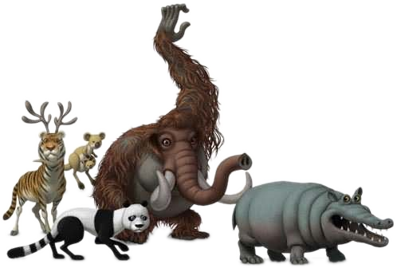
Polymorphism
Live Demo
Notes:
(c) 2006 National Academy for Software Development - http://academy.devbg.org*
45##

Slide 46
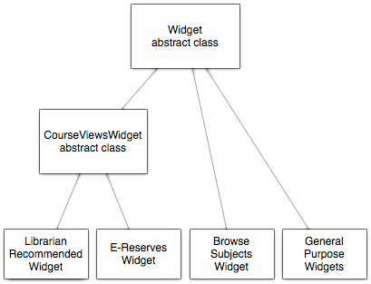
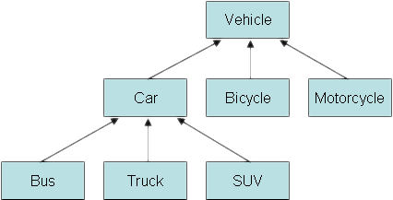
Class Hierarchies: Real World Example
Notes:
(c) 2006 National Academy for Software Development - http://academy.devbg.org*
46##

Slide 47
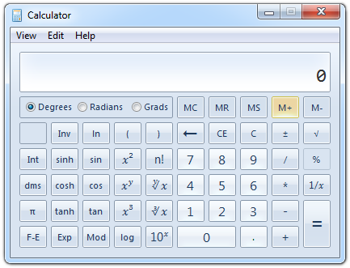
Real World Example: Calculator
Creating an application like the Windows Calculator
Typical scenario for applying the object-oriented approach
47

Slide 48
Real World Example: Calculator (2)
The calculator consists of controls:
Buttons, panels, text boxes, menus, check boxes, radio buttons, etc.
Class Control – the root of our OO hierarchy
All controls can be painted on the screen
Should implement an interface IPaintable with a method Paint()
Common properties: location, size, text, face color, font, background color, etc.
48

Slide 49
Real World Example: Calculator (3)
Some controls could contain other (nested) controls inside (e. g. panels and toolbars)
We should have class Container that extends Control holding a collection of child controls
The Calculator itself is a Form
Form is a special kind of Container
Contains also border, title (text derived from Control), icon and system buttons
How the Calculator paints itself?
Invokes Paint() for all child controls inside it
49

Slide 50
Real World Example: Calculator (4)
How a Container paints itself?
Invokes Paint() for all controls inside it
Each control knows how to visualize itself
What is the common between buttons, check boxes and radio buttons?
Can be pressed
Can be selected
We can define class AbstractButton and all buttons can derive from it
50

Slide 51
Calculator Classes
«interface»
IPaintable
Paint()
Control
-location
-size
-text
-bgColor
-faceColor
-font
Container
AbstractButton
TextBox
MainMenu
MenuItem
Panel
Form
Button
CheckBox
RadioButton
Calculator
51

Slide 52

Cohesion and Coupling

Slide 53
Cohesion
Cohesion describes how closely all the routines in a class or all the code in a routine support a central purpose
Cohesion must be strong
Well-defined abstractions keep cohesion strong
Classes must contain strongly related functionality and aim for single purpose
Cohesion is a useful tool for managing complexity

Slide 54


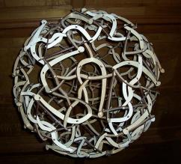
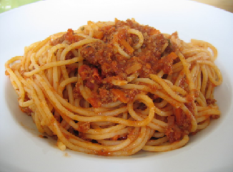
Good and Bad Cohesion
Good: hard disk, cdrom, floppy
BAD: spaghetti code

Slide 55
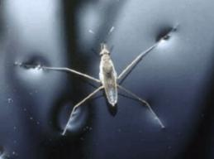
Strong Cohesion
Strong cohesion example
Class Math that has methods:
Sin(), Cos(), Asin()
Sqrt(), Pow(), Exp()
Math.PI, Math.E
double sideA = 40, sideB = 69;
double angleAB = Math.PI / 3;
double sideC =
Math.Pow(sideA, 2) + Math.Pow(sideB, 2)
- 2 * sideA * sideB * Math.Cos(angleAB);
double sidesSqrtSum = Math.Sqrt(sideA) + Math.Sqrt(sideB) + Math.Sqrt(sideC);

Slide 56
Bad Cohesion
Bad cohesion example
Class Magic that has these methods:
Another example:
public void PrintDocument(Document d);
public void SendEmail(
string recipient, string subject, string text);
public void CalculateDistanceBetweenPoints(
int x1, int y1, int x2, int y2)
MagicClass.MakePizza("Fat Pepperoni");
MagicClass.WithdrawMoney("999e6");
MagicClass.OpenDBConnection();

Slide 57
Coupling
Coupling describes how tightly a class or routine is related to other classes or routines
Coupling must be kept loose
Modules must depend little on each other
All classes and routines must have small, direct, visible, and flexible relations to other classes and routines
One module must be easily used by other modules

Slide 58
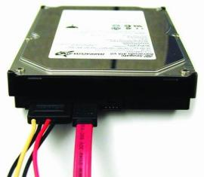
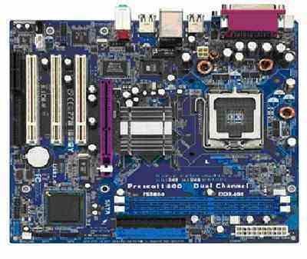
Loose and Tight Coupling
Loose Coupling:
Easily replace old HDD
Easily place this HDD to another motherboard
Tight Coupling:
Where is the video adapter?
Can you change the video controller?

Slide 59
Loose Coupling – Example
class Report
{
public bool LoadFromFile(string fileName) {…}
public bool SaveToFile(string fileName) {…}
}
class Printer
{
public static int Print(Report report) {…}
}
class Program
{
static void Main()
{
Report myReport = new Report();
myReport.LoadFromFile("C:\\DailyReport.rep");
Printer.Print(myReport);
}
}

Slide 60
Tight Coupling – Example
class MathParams
{
public static double operand;
public static double result;
}
class MathUtil
{
public static void Sqrt()
{
MathParams.result = CalcSqrt(MathParams.operand);
}
}
class MainClass
{
static void Main()
{
MathParams.operand = 64;
MathUtil.Sqrt();
Console.WriteLine(MathParams.result);
}
}

Slide 61
Spaghetti Code
Combination of bad cohesion and tight coupling:
class Report
{
public void Print() {…}
public void InitPrinter() {…}
public void LoadPrinterDriver(string fileName) {…}
public bool SaveReport(string fileName) {…}
public void SetPrinter(string printer) {…}
}
class Printer
{
public void SetFileName() {…}
public static bool LoadReport() {…}
public static bool CheckReport() {…}
}

Slide 62
Summary
OOP fundamental principals are: inheritance, encapsulation, abstraction, polymorphism
Inheritance allows inheriting members form another class
Abstraction and encapsulation hide internal data and allow working through abstract interface
Polymorphism allows working with objects through their parent interface and invoke abstract actions
Strong cohesion and loose coupling avoid spaghetti code

Slide 63


Object-Oriented Programming Fundamental Concepts
Questions?
http://academy.telerik.com

Slide 64
Exercises
We are given a school. In the school there are classes of students. Each class has a set of teachers. Each teacher teaches a set of disciplines. Students have name and unique class number. Classes have unique text identifier. Teachers have name. Disciplines have name, number of lectures and number of exercises. Both teachers and students are people.
Your task is to identify the classes (in terms of OOP) and their attributes and operations, define the class hierarchy and create a class diagram with Visual Studio.
64

Slide 65
Exercises (2)
Define class Human with first name and last name. Define new class Student which is derived from Human and has new field – grade. Define class Worker derived from Human with new field weekSalary and work-hours per day and method MoneyPerHour() that returns money earned by hour by the worker. Define the proper constructors and properties for this hierarchy. Initialize an array of 10 students and sort them by grade in ascending order. Initialize an array of 10 workers and sort them by money per hour in descending order.
65

Slide 66
Exercises (3)
Define abstract class Shape with only one virtual method CalculateSurface() and fields width and height. Define two new classes Triangle and Rectangle that implement the virtual method and return the surface of the figure (height*width for rectangle and height*width/2 for triangle). Define class Circle and suitable constructor so that on initialization height must be kept equal to width and implement the CalculateSurface() method. Write a program that tests the behavior of the CalculateSurface() method for different shapes (Circle, Rectangle, Triangle) stored in an array.
66

Slide 67
Exercises (4)
Create a hierarchy Dog, Frog, Cat, Kitten, Tomcat and define suitable constructors and methods according to the following rules: all of this are Animals. Kittens and tomcats are cats. All animals are described by age, name and sex. Kittens can be only female and tomcats can be only male. Each animal produce a sound. Create arrays of different kinds of animals and calculate the average age of each kind of animal using static methods. Create static method in the animal class that identifies the animal by its sound.
67

Slide 68
Exercises (5)
A bank holds different types of accounts for its customers: deposit accounts, loan accounts and mortgage accounts. Customers could be individuals or companies.
All accounts have customer, balance and interest rate (monthly based). Deposit accounts are allowed to deposit and with draw money. Loan and mortgage accounts can only deposit money.

Slide 69
Exercises (6)
All accounts can calculate their interest amount for a given period (in months). In the common case its is calculated as follows: number_of_months * interest_rate.
Loan accounts have no interest for the first 3 months if are held by individuals and for the first 2 months if are held by a company.
Deposit accounts have no interest if their balance is positive and less than 1000.
Mortgage accounts have ½ interest for the first 12 months for companies and no interest for the first 6 months for individuals.

Slide 70
Exercises (7)
Your task is to write a program to model the bank system by classes and interfaces. You should identify the classes, interfaces, base classes and abstract actions and implement the calculation of the interest functionality.

